Slide 1

Chapter 4:
Correlation and Regression
^{Discovering Statistics}
^{2nd Edition Daniel T. Larose}
Lecture PowerPoint Slides
Notes:
Basic Practice of Statistics - 3rd Edition
Chapter 5

Slide 2

Chapter 4 Overview
4.1 Scatterplots and Correlation
4.2 Introduction to Regression
4.3 Further Topics in Regression

Slide 3
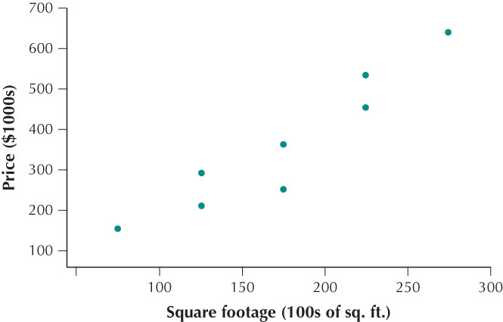
Scatterplots
Whenever you are examining the relationship between two quantitative variables, your best bet is to start with a scatterplot. A scatterplot is used to summarize the relationship between two quantitative variables that have ben measured on the same element.
A scatterplot is a graph of points (x,y), each of which represents one observation from the data set.
One of the variables is measured along the horizontal axis and is called the x variable.
The other variable is measured along the vertical axis and is called the y variable.
Lot | x=square footage (100s of sq ft) | y=sales price ($1000s)
Harding St | 75 | 155
Newton Ave | 125 | 210
Stacy Ct | 125 | 290
Eastern Ave | 175 | 360
Second St | 175 | 250
Sunnybrook Rd | 225 | 450
Ahlstrand Rd | 225 | 530
Eastern Ave | 275 | 635

Slide 4
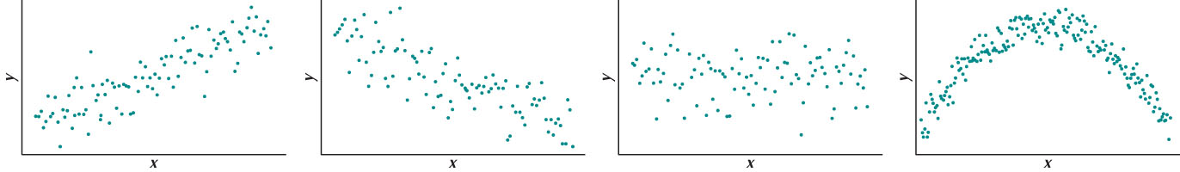
Scatterplots
The relationship between two quantitative variables can take many different forms. Four of the most common are:
Positive linear relationship: As x increases, y also tends to increase.
Negative linear relationship: As x increases, y tends to decrease.
No apparent relationship: As x increases, y tends to remain unchanged.
Nonlinear relationship: The x and y variable are related, but not in a way that can be approximated using a straight line.

Slide 5
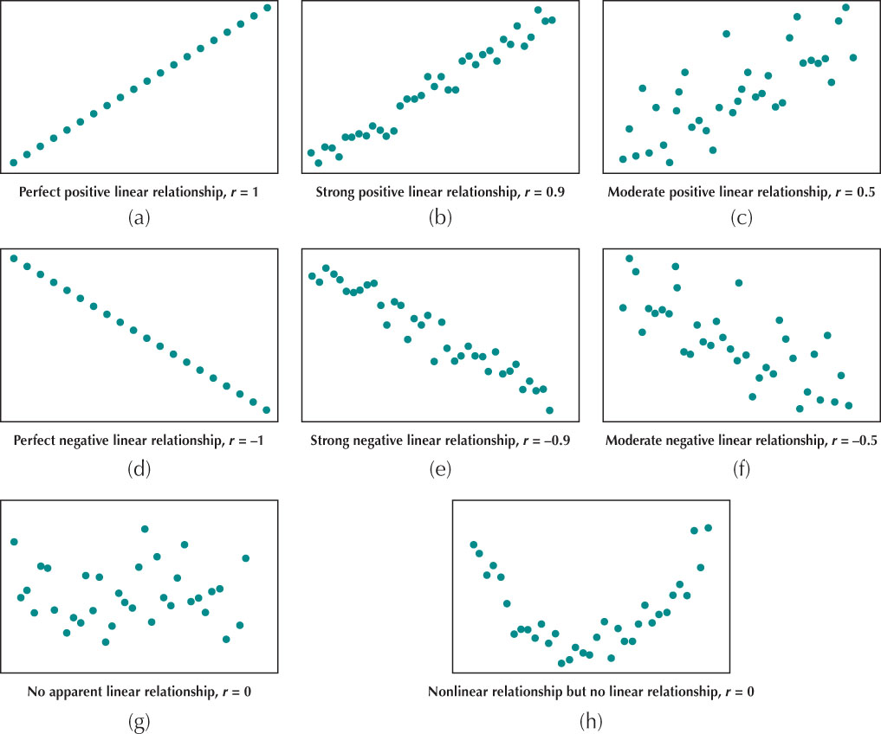
Properties of r

